Slide 1
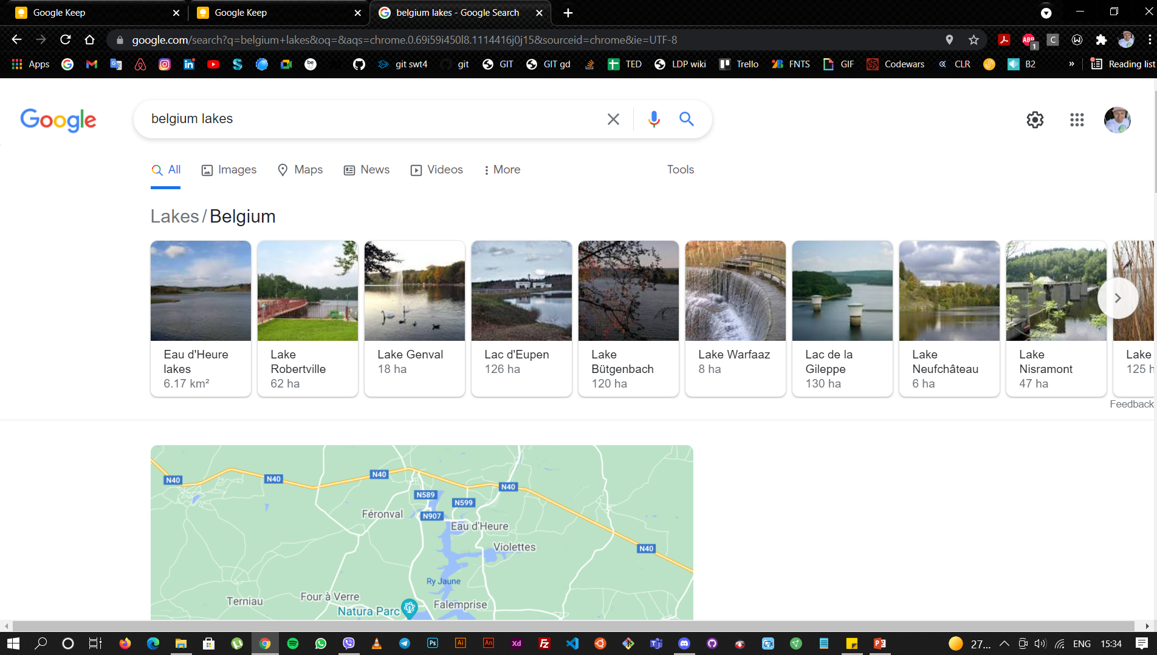
Application Draft Concept

Slide 2
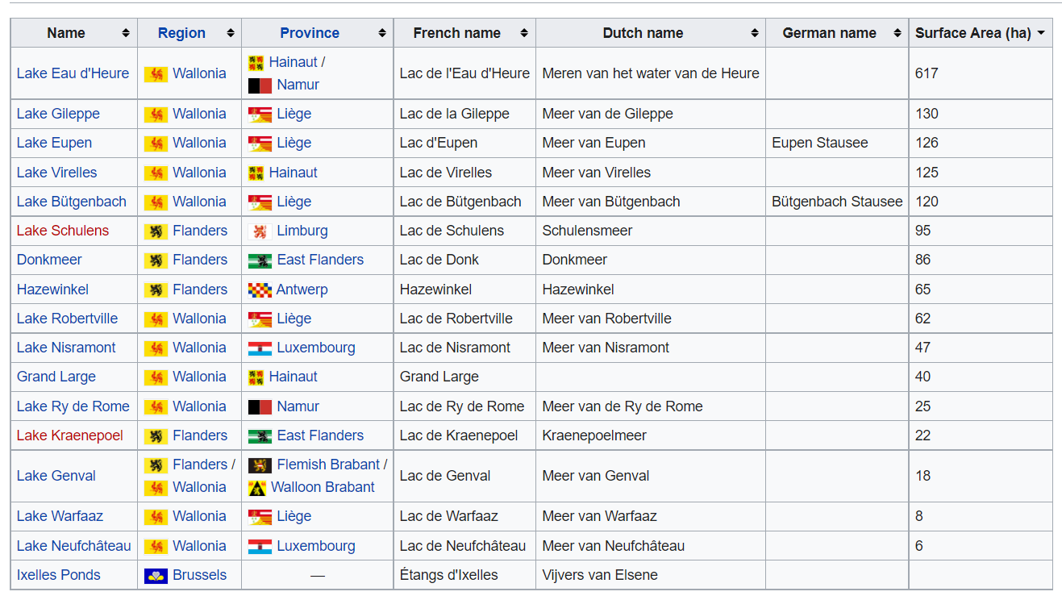
Application Draft Concept

Slide 3
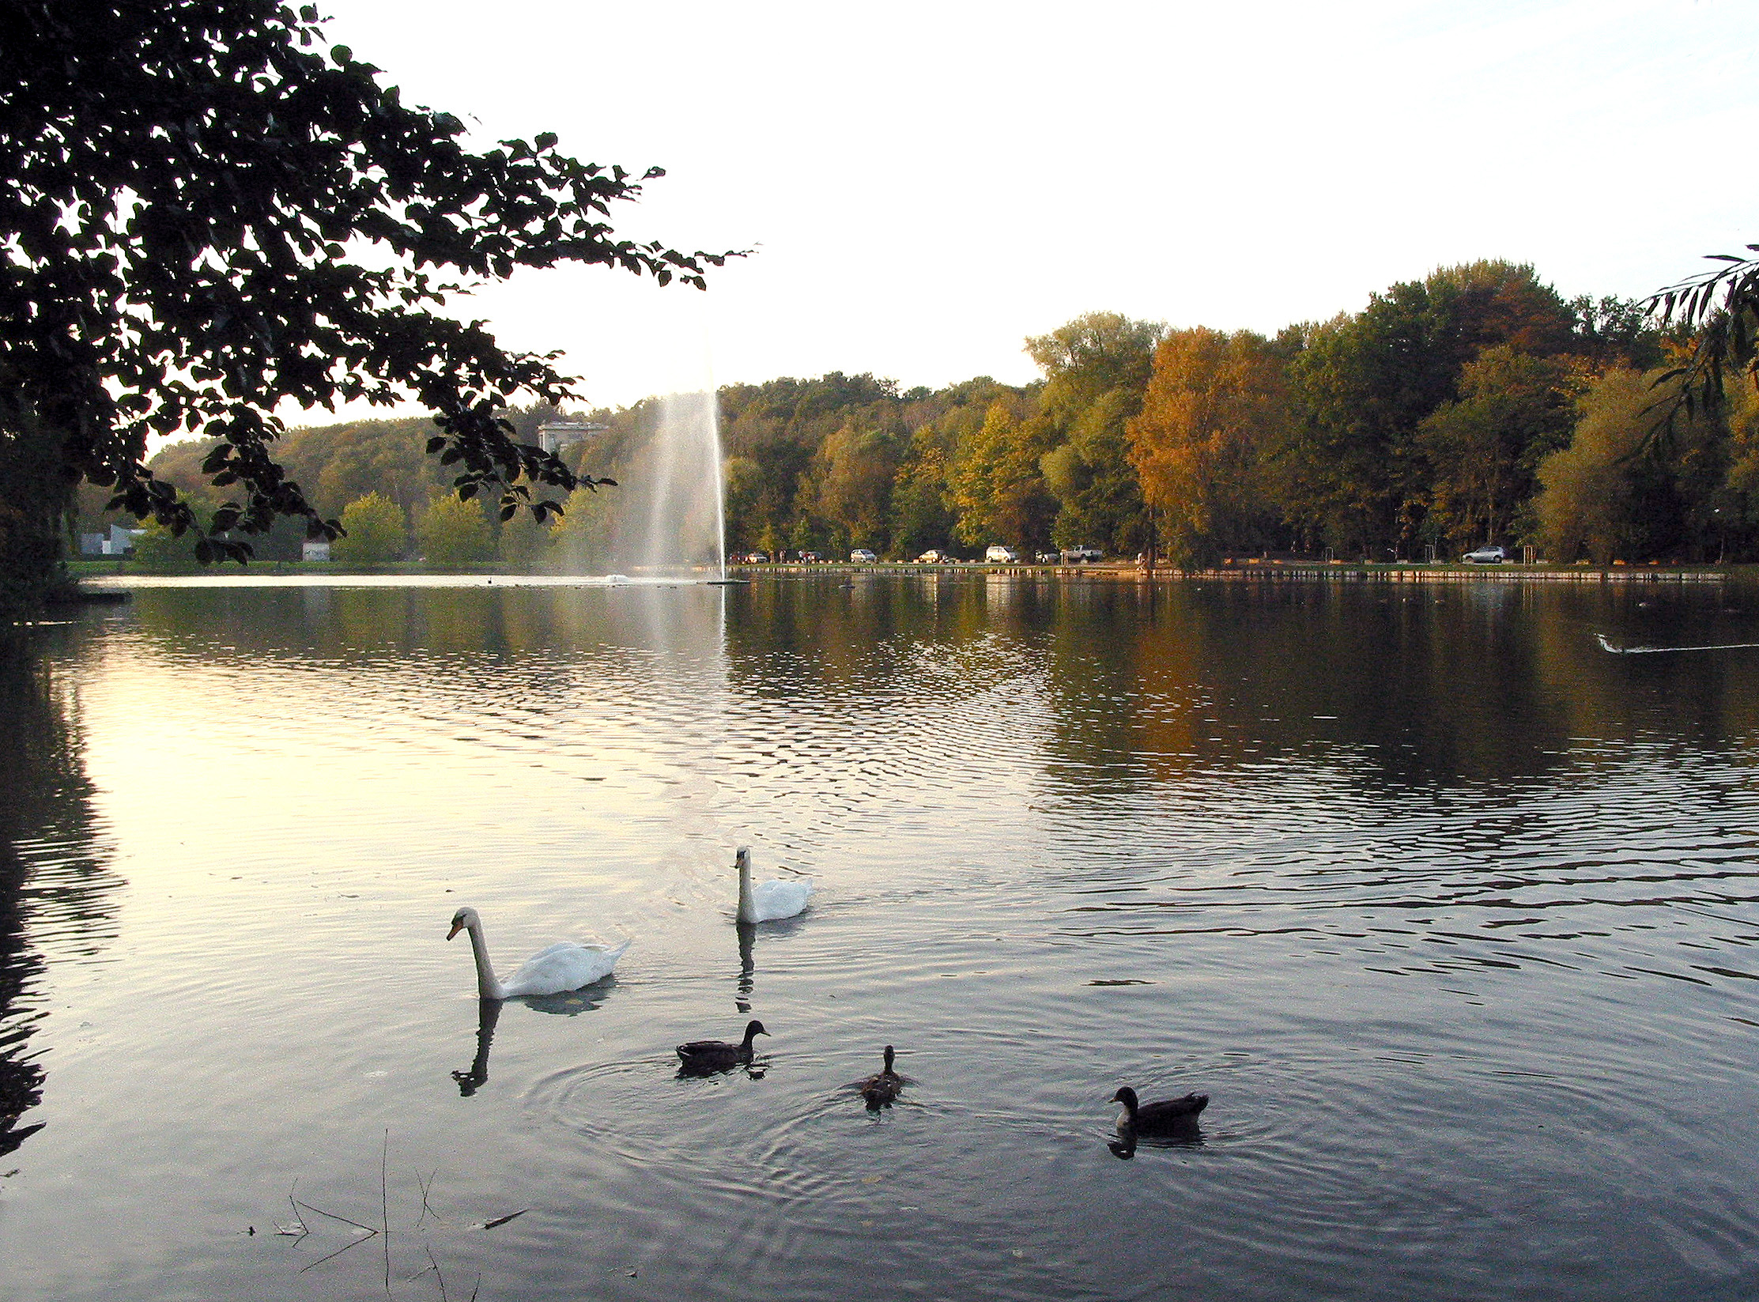
L
Be ake
Application Draft Concept
Issue to solve: there is no united easy-to-use data of lakes in Belgium
Way to solve it: easy-to-use app with filters according to users needs
Core feature: unified list of lakes with UX friendly way of choosing your favorite place for a weekend BBQ / Kayaking / Fishing lake near by the house (geolocation) or by your favorite region
or by special needs feature (disable, dog, electric car etc)
Lake Hofstad
18 km
17 C
Lake Genval
Target groups: Belgian, Dutch, French, German holidaymakers
36 km
17 C
Layout: Preloading page (Logo, Lake with moving water)
Home page (Banner, Burger, List of lakes)
Page for each lake (or drop down extension)
Search + Filters
My favourites
Lake Eupen
42 km
17 C
Development: Front end design and prototyping in Figma
Back End
Data base of lakes
API for water temperature
Lake Boom
18 km
17 C

Slide 4
L
Be ake
Application Draft Concept
Main Features shown by Icons
Beach - Changing rooms - Lockers – Showers - Pets friendly
Water Temperature
BBQ - Picnic area
Food court Kayak - Boat - Catamaran rent
Toilets Children playground
Sportive facilities Disabled access
Public transport access
Bike rent
Parking / Fuel station / Electric car charger Camping Fishing (attention for licence payment )
Inflatable boat authorisation Fountain Wifi 360 photos
Lake Hofstad
18 km
17 C
Lake Genval
36 km
17 C
Lake Eupen
42 km
17 C
Lake Boom
18 km
17 C

